Slide 1
Session 8 Applying modelling techniques to analyze (seroprevalence) data

Slide 2
Aims and objectives
Aim: Applying modelling techniques to analyze seroprevalence data to estimate the key parameters used in the model
Objectives
Relationship between long-term data on the infection incidence and cross-sectional data on the age-specific prevalence of previous infection
Estimate the average force of infection by fitting a catalytic model to seroprevalence data
Calculate the average age at infection, proportion susceptible and R₀ using the force of infection

Slide 3
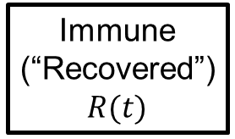
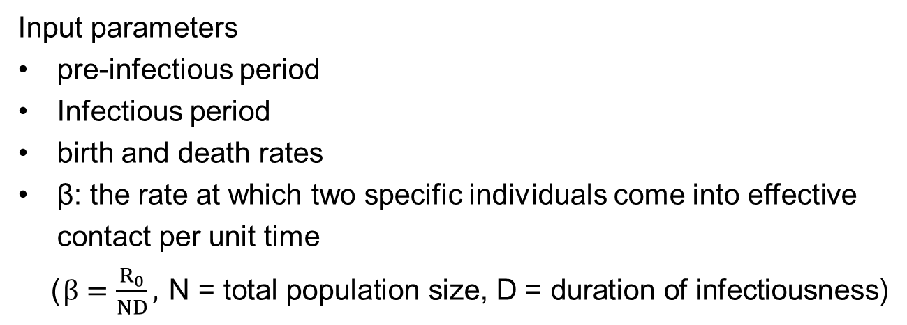
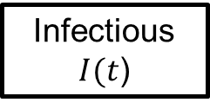
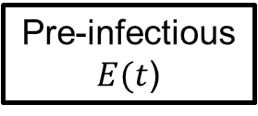

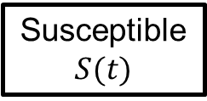


Structure of the model
$$βS\left(t\right)I(t)$$
$$fE(t)$$
$$rI(t)$$
Immune (“Recovered”)
$$R(t)$$
Susceptible $$S(t)$$
Pre-infectious $E(t$)
Infectious
$I(t$)
deaths
deaths
deaths
deaths
Input parameters
pre-infectious period
Infectious period
birth and death rates
β: the rate at which two specific individuals come into effective contact per unit time
($β=\frac{R_{0}}{ND},$N = total population size, D = duration of infectiousness)
Q: HOW DO WE ESTIMATE $R_{0}$?
Notes:
The first four parameters in this list are usually known for most infections and populations.
However, the parameter β is poorly understood and difficult to measure directly, and we have usually calculated it from the basic reproduction number, R0, using the equation: $β=\frac{R_{0}}{ND}$
During the exercises, we have usually provided the value for R0 to use in models. How do we know the value for R0?

Slide 4
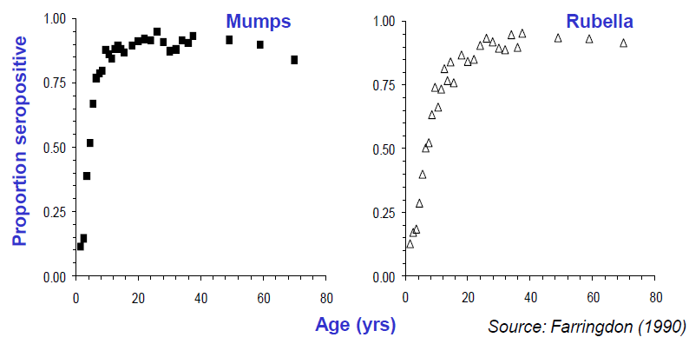
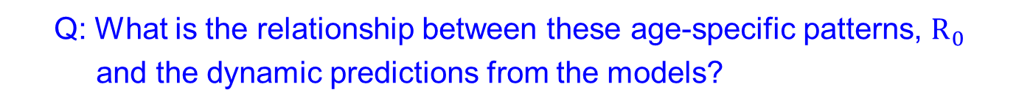
Proportion of individuals seropositive to mumps and rubella antibodies in the UK (late 1980s)
Q: What is the relationship between these age-specific patterns, $R_{0}$
and the dynamic predictions from the models?
Notes:
We can often estimate R0 for a given infection using data on the age-specific proportion of individuals who have previously experienced infection, such as those shown in Figure above.
These show that the proportion of individuals who had antibodies to mumps and rubella and who, in the absence of vaccination, had therefore probably been infected, increased with increasing age.
In addition, the proportion of individuals who had antibodies to mumps increased more rapidly with age than that for rubella, suggesting that mumps was more infectious than was rubella.
In fact, using data such as these, we can estimate several important epidemiological indices, in addition to the basic reproduction number:
• the average force of infection
• the average age at infection
• the herd immunity threshold
• the number of new infections which might occur in different age groups per unit time

Slide 5
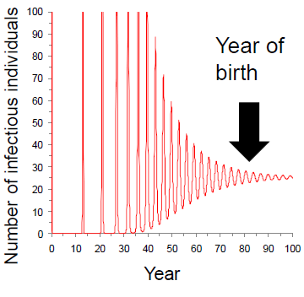
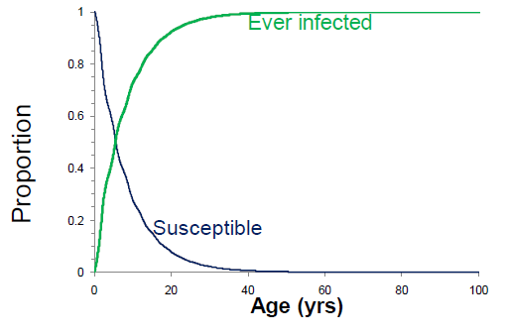
Relation between age-specific proportion seropositive and predictions from a dynamic model
Predictions from a dynamic model
Age-specific proportion seropositive
If we were track to individuals born in year 80, proportion of individuals who have ever experienced infection (seropositive) change as the cohort ages. If an infection is endemic, these patterns should be similar to those seen in cross-sectional data.
Notes:
Predictions of the proportion of a cohort born in year 80 who should have ever been infected or who are still susceptible by the time they reach different ages.

Slide 6
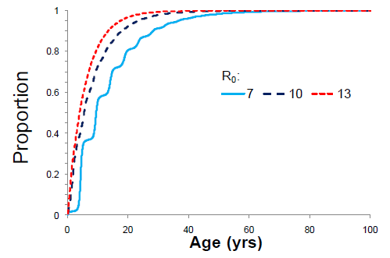
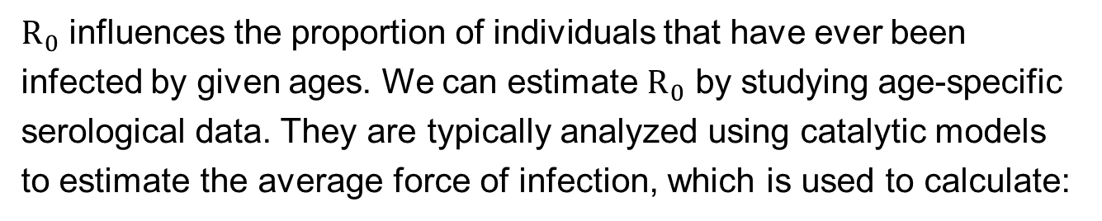
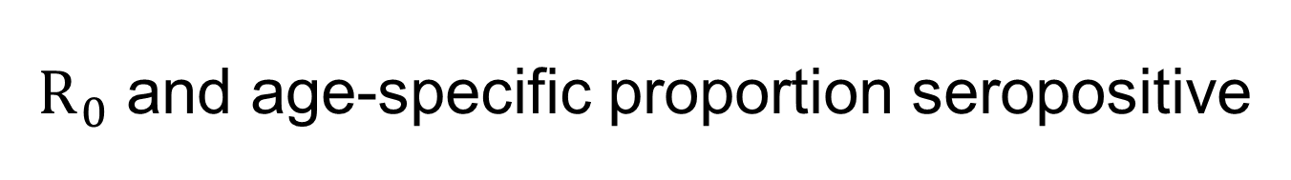
$R_{0}$ and age-specific proportion seropositive
$R_{0}$ influences the proportion of individuals that have ever been infected by given ages. We can estimate $R_{0}$ by studying age-specific serological data. They are typically analyzed using catalytic models to estimate the average force of infection, which is used to calculate:
The average age at infection
The proportion susceptible
R₀ and herd immunity threshold
Infection incidence

Slide 7
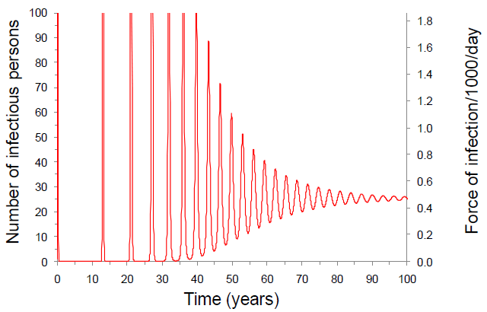
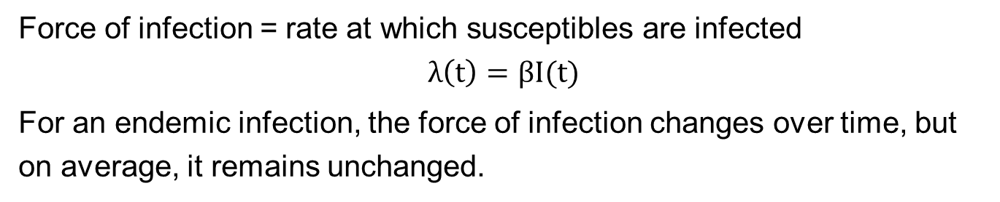
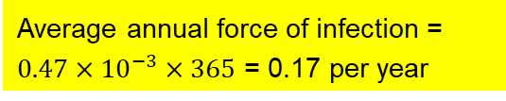
1. Average force of infection
Force of infection = rate at which susceptibles are infected
$$λ\left(t\right)=βI(t)$$
For an endemic infection, the force of infection changes over time, but on average, it remains unchanged.
Average annual force of infection = $0.47×{10}^{−3}×365$ = 0.17 per year

Slide 8
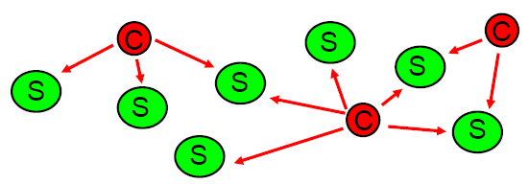
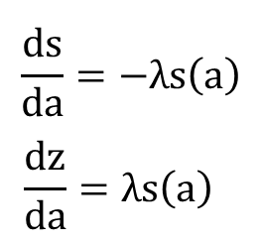

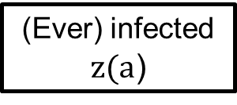
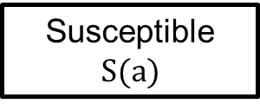
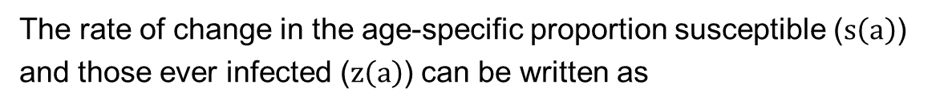
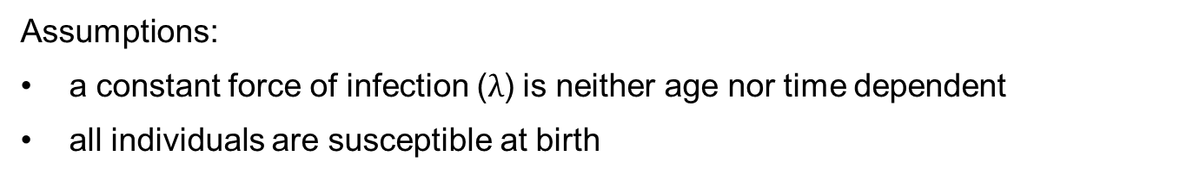
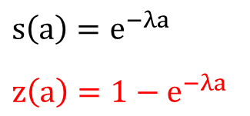
Catalytic models
$$λ$$
Susceptible $$S(a)$$
(Ever) infected $z(a$)
Assumptions:
a constant force of infection ($λ$) is neither age nor time dependent
all individuals are susceptible at birth
The rate of change in the age-specific proportion susceptible ($s\left(a\right)$) and those ever infected ($z\left(a\right)$) can be written as
$$\frac{ds}{da}=−λs\left(a\right)$$
$$\frac{dz}{da}=λs\left(a\right)$$
$$s\left(a\right)=e^{−λa}$$
$$z\left(a\right)=1−e^{−λa}$$
Notes:
Illustration of the catalytic (or infection) process: Műnch(1959)
In a “typical” catalytic process, the molecules of the original substance (denoted by S) are exposed to the molecules of some catalyst (denoted by C) which were remain unchanged over time.
Thus the molecules of the original substance are exposed to a constant force converting them into a new substance.
By analogy, in an infection process, infectious persons (cases) “C” converting susceptible individuals “S” into those who have ever been infected, who then become immune
*The analogy is imperfect, because, in contrast with the catalyst, the number of infectious persons (and thus the force of infection) changes over time

Slide 9
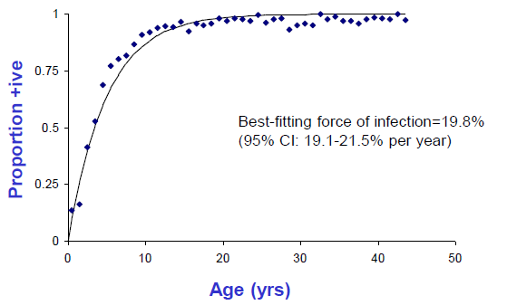
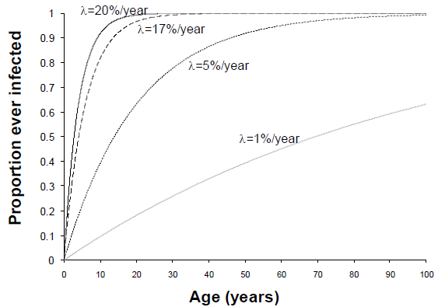

Fitting catalytic model to seropositive data
$$z\left(a\right)=1−e^{−λa}$$
Comparison between the mumps data observed in the UK and best-fitting simple catalytic model

Slide 10
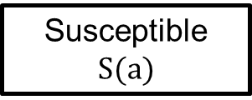
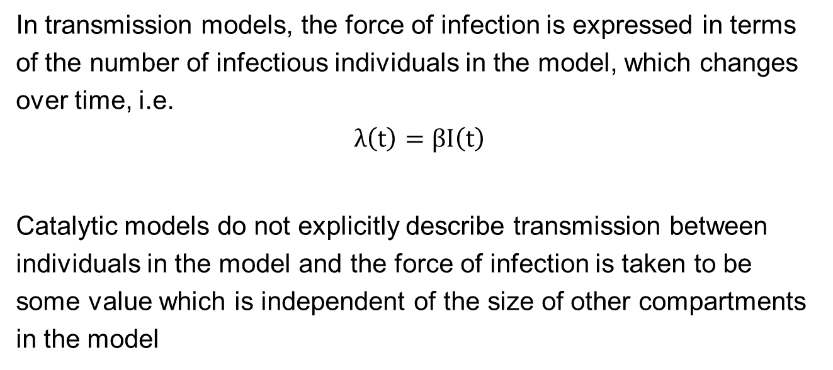

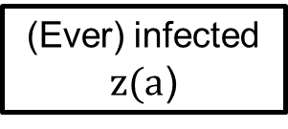
Catalytic model and transmission model
In transmission models, the force of infection is expressed in terms of the number of infectious individuals in the model, which changes over time, i.e.
$$λ\left(t\right)=βI\left(t\right)$$
Catalytic models do not explicitly describe transmission between individuals in the model and the force of infection is taken to be some value which is independent of the size of other compartments in the model
$$λ$$
Susceptible $$S(a)$$
(Ever) infected $z(a$)

Slide 11
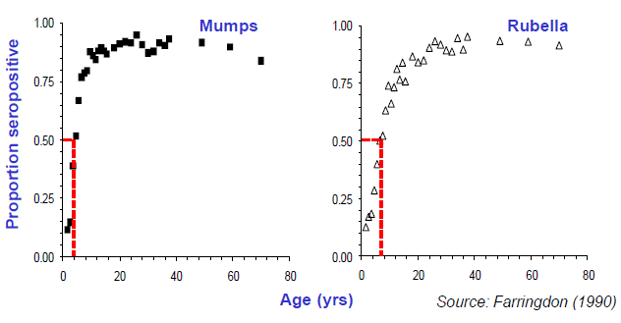
2. Average age at infection
The median age at infection (very quick and crude) is obtained by reading off the age by which 50% of individuals are seropositive
Observed proportion of seropositive to mumps and rubella antibodies in the UK (late 1980s)

Slide 12
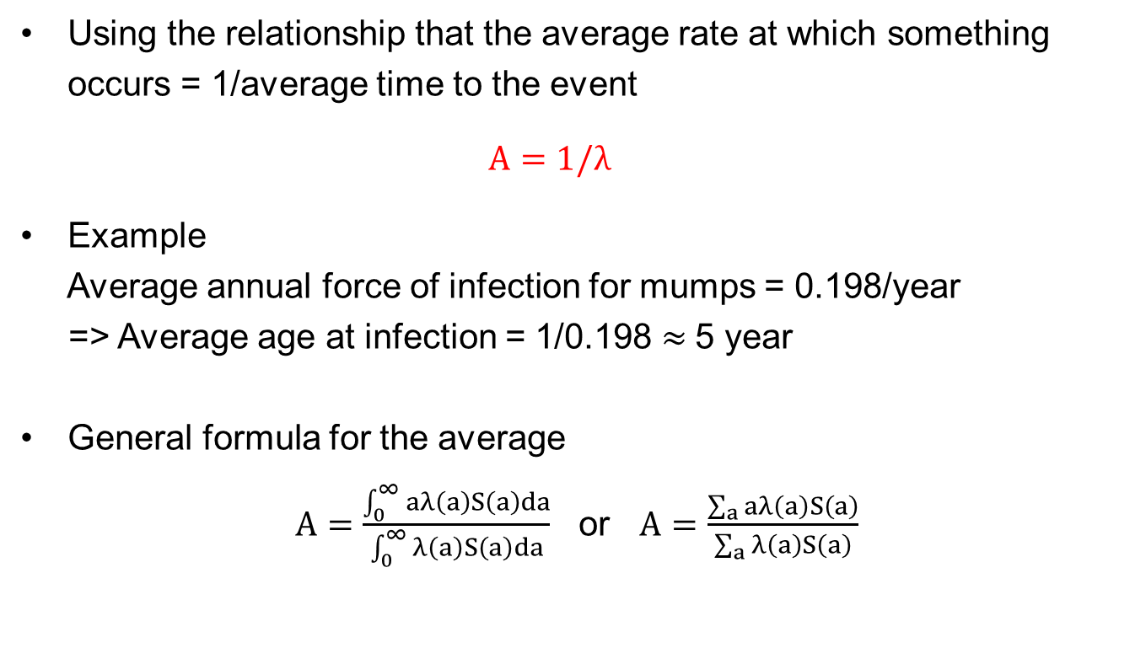
The average age at infection from the average force of infection
Using the relationship that the average rate at which something occurs = 1/average time to the event
$$A=1/λ$$
Example
Average annual force of infection for mumps = 0.198/year
=> Average age at infection = 1/0.198 $≈$5 year
General formula for the average
$A=\frac{\int_{0}^{∞}{aλ\left(a\right)S\left(a\right)da}}{\int_{0}^{∞}{λ\left(a\right)S\left(a\right)da}}$ or $A=\frac{\sum_{a}{aλ\left(a\right)S\left(a\right)}}{\sum_{a}{λ\left(a\right)S\left(a\right)}}$
number of new infections at age a
Notes:
This relationship is approximate, since the average age at infection depends on how many individuals die before being infected and hence on the mortality rate.
It also assumes that the force of infection is independent of age and that individuals mix randomly.

Slide 13
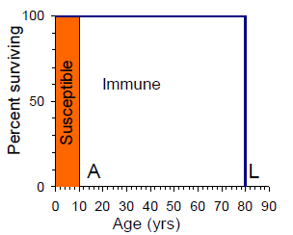
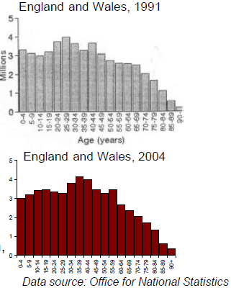
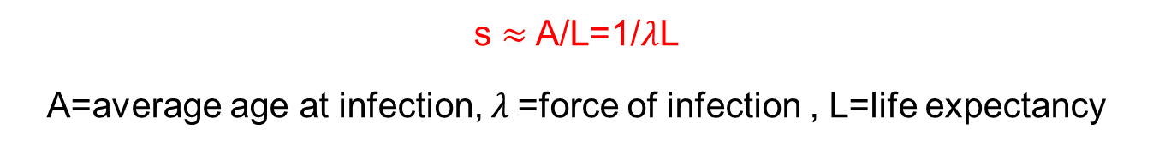
3. The proportion susceptible
Rectangular populations:
s $≈$ A/L=1/$λ$L
A=average age at infection, $λ$=force of infection , L=life expectancy
Notes:
The proportion of the population that is susceptible depends both on the rate at which individuals become infected, and the death rate in the population.
If we assume that individuals mix randomly, then in populations with “rectangular” age distributions, it can be assumed that everybody lives only until age L,
and “on average” everyone is susceptible until the average age A and everyone above that age is immune.

Slide 14
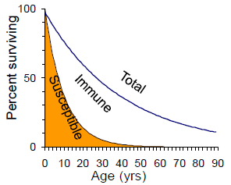
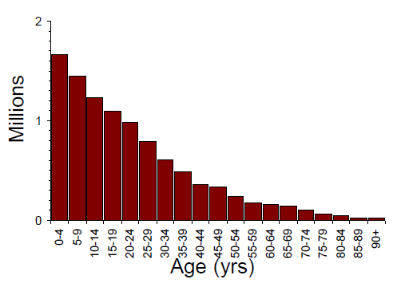

The proportion susceptible
Exponential populations:
National Statistical Office, Malawi 1998
s $≈$ 1/($1+L/A$) = 1/$(1+λL$)
A=average age at infection, L=life expectancy

Slide 15

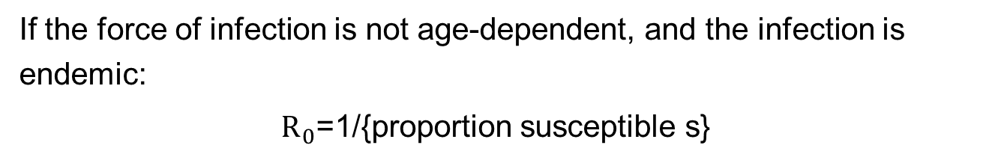
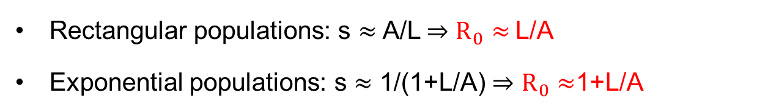
4. Basic reproduction number $R_{0}$
If the force of infection is not age-dependent, and the infection is endemic:
$R_{0}$=1/{proportion susceptible s}
Note: $R_{n}$=$R_{0}×s$, and $R_{n}$=1 for endemic infection
Rectangular populations: s $≈$ A/L$⇒$ $R_{0}≈$L/A
Exponential populations: s $≈$ 1/(1+L/A) $⇒$ $R_{0}≈$1+L/A

Slide 16

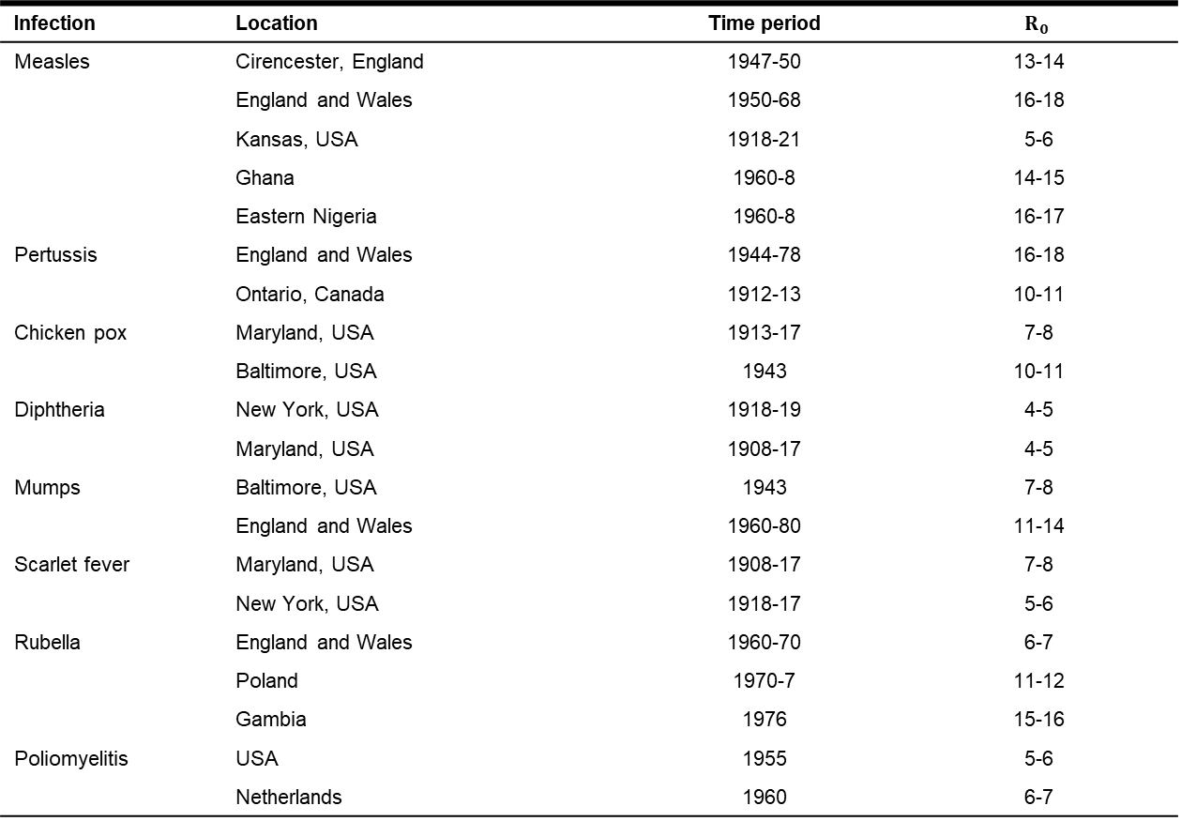
Estimates of $R_{0}$ for different infections
Infection | Location | Time period | $$R_{0}$$
Measles | Cirencester, England | 1947-50 | 13-14
 | England and Wales | 1950-68 | 16-18
 | Kansas, USA | 1918-21 | 5-6
 | Ghana | 1960-8 | 14-15
 | Eastern Nigeria | 1960-8 | 16-17
Pertussis | England and Wales | 1944-78 | 16-18
 | Ontario, Canada | 1912-13 | 10-11
Chicken pox | Maryland, USA | 1913-17 | 7-8
 | Baltimore, USA | 1943 | 10-11
Diphtheria | New York, USA | 1918-19 | 4-5
 | Maryland, USA | 1908-17 | 4-5
Mumps | Baltimore, USA | 1943 | 7-8
 | England and Wales | 1960-80 | 11-14
Scarlet fever | Maryland, USA | 1908-17 | 7-8
 | New York, USA | 1918-17 | 5-6
Rubella | England and Wales | 1960-70 | 6-7
 | Poland | 1970-7 | 11-12
 | Gambia | 1976 | 15-16
Poliomyelitis | USA | 1955 | 5-6
 | Netherlands | 1960 | 6-7

Slide 17
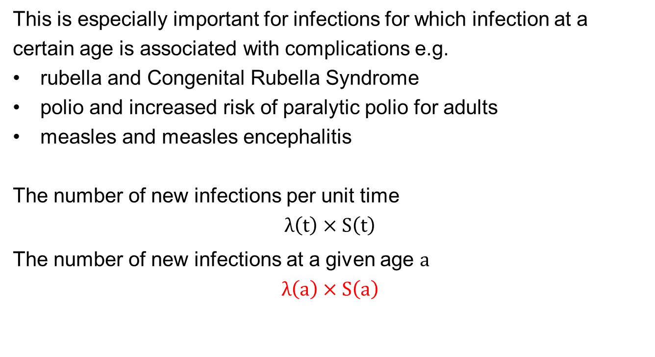
5. Age-specific incidence of infection
This is especially important for infections for which infection at a certain age is associated with complications e.g.
rubella and Congenital Rubella Syndrome
polio and increased risk of paralytic polio for adults
measles and measles encephalitis
The number of new infections per unit time
$$λ\left(t\right)×S\left(t\right)$$
The number of new infections at a given age $a$
$$λ\left(a\right)×S\left(a\right)$$

Slide 18
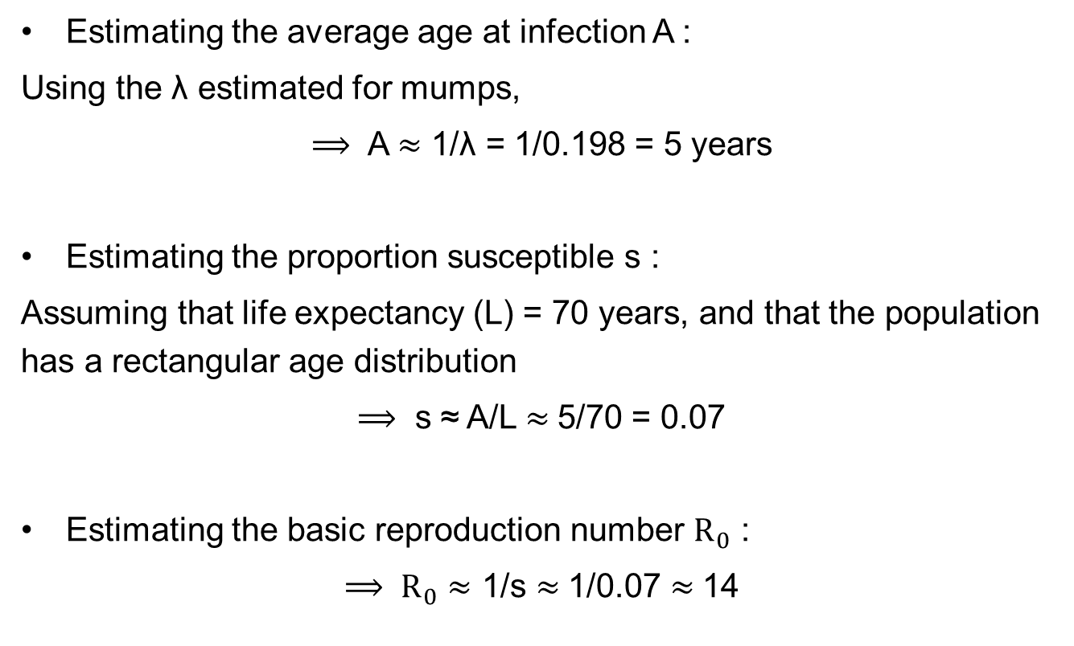
Example: Use of the average force of infection
Estimating the average age at infection A :
Using the λ estimated for mumps,
$⟹$ A $≈\text{1/}\text{λ}$ = 1/0.198 = 5 years
Estimating the proportion susceptible s :
Assuming that life expectancy (L) = 70 years, and that the population has a rectangular age distribution
$⟹$ s ≈ A/L $≈$5/70 = 0.07
Estimating the basic reproduction number $R_{0}$ :
$⟹ R_{0}$ $≈$ 1/s $≈$1/0.07 $≈$14

Slide 19

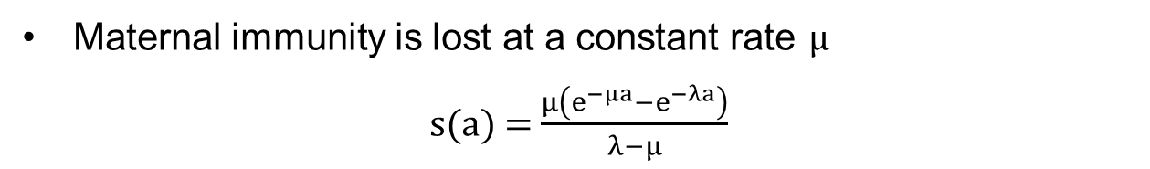



► Maternally-derived immunity
Solid immunity to infection during the first 6 months of life
s(a) = e$(^{−λ\left(a−0.5\right)})$
Maternal Protection
Susceptible $$s(a)$$
$$λ$$
(Ever) infected $z(a$)
Maternal immunity is lost at a constant rate μ
s(a) = $\frac{μ\left(e^{−μa}−e^{−λa}\right)}{λ−μ}$
Notes:
Fine-tuning simple catalytic models:
a) Maternally-derived immunity
b) Age-dependency in the force of infection
Maternal immunity is lost at a constant rate μ → (after some calculations…) s(a)=$\frac{μ\left(e^{−μa}−e^{−λa}\right)}{λ−μ}$

Slide 20
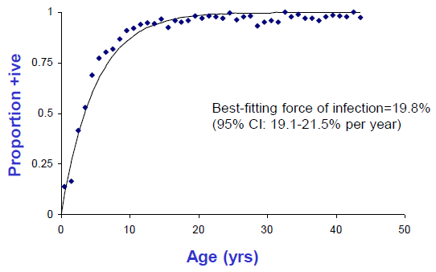
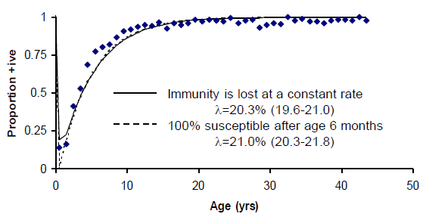
Observed data and best-fitting model
Notes:
Comparison between the observed seropositivity to mumps (UK) and the expected prevalence of infection using a simple catalytic model with maternal immunity
The force of infection estimated by fitting a simple catalytic model to the data may underestimate the true force of infection

Slide 21
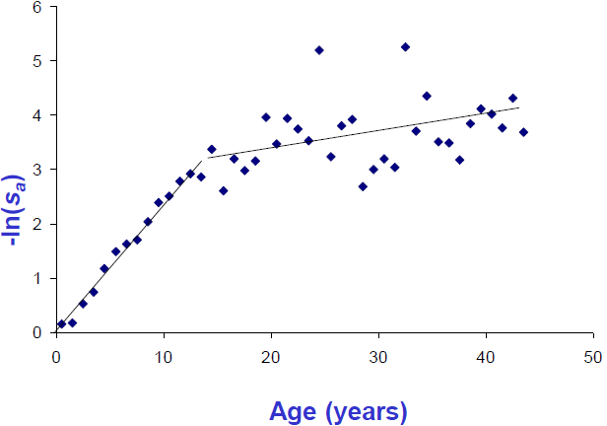
► Age-dependency in the force of infection
Plot –ln{observed proportion seronegative} against the age
If the resulting plot is a straight line, then:
the force of infection is the same for all age groups
the gradient of the line equals the force of infection, λ
Otherwise, the force of infection cannot be assumed to be constant with age.
Notes:
The assumption that the force of infection does not depend on age may be inappropriate for some infections.
For the mumps example described above, model predictions underestimate the proportion of 5-14 year olds and overestimate the proportion of older individuals.
Graphical methods can be used to determine whether or not the force of infection is age-dependent.
λ is constant in the age ranges 0<15 years and ≥15 years, but differs between these two age groups

Slide 22
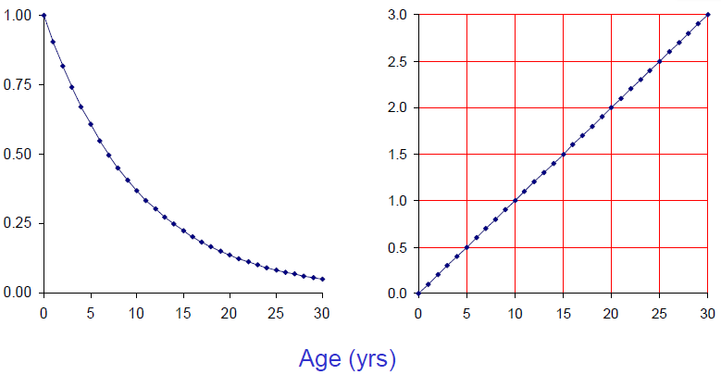



Age-dependency in the force of infection
If the force of infection is not age-dependent, then the proportion of individuals of age a who are susceptible is given by
${s(a)=e}^{−λa}$
$$\ln\left\{s\left(a\right)\right\}=\ln\left(e^{−λa}\right) or −\ln\left\{s\left(a\right)\right\}=λa$$
$$s\left(a\right)=e^{−0.1a}$$
$$−\ln\left(s\left(a\right)\right)=0.1a$$

Slide 23
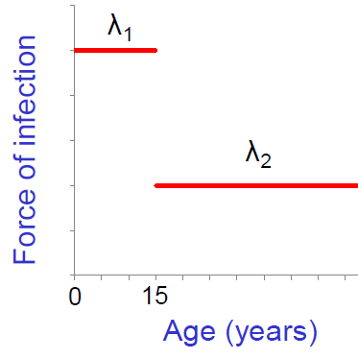
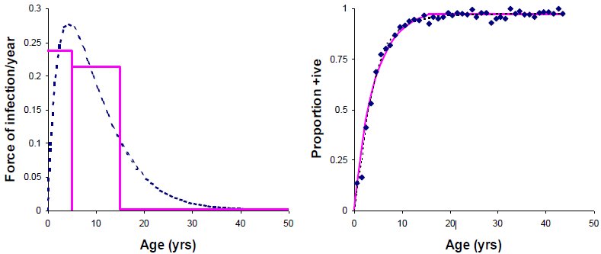


Age-dependent force of infection
We assume that the force of infection differs between the age groups <15 and $≥$15 years (denoted by $λ_{1}$ and $λ_{2}$)
The proportion susceptible
s$\left(a\right)=\left\{\begin{aligned}e^{−λ_{1}a} a<15 years \\ &e^{−15λ_{1}}e^{−λ_{2}\left(a−15\right)} a≥15 years\end{aligned}\right.$

Slide 24




► Variants of the simple catalytic model
Reversible or SIS model: tuberculin, diphtheria, malaria, filariasis
$$λ$$
Susceptible
Infected
$$μ$$
2 stage or SIR: yaws, histoplasmosis
Susceptible
Infected
Recovered
Compound model: hookworm
Susceptible
Infected
Recovered

Slide 25



A1: The proportion susceptible s $≈$ 1/(1+L/A)
proportion of the original cohort still alive by age a$e^{−ma}$
proportion of the original cohort still alive and susceptible $e^{−\left(m+λ\right)a}$
Assuming that a total of $N_{0}$ individuals are born each year and that the number of population is constant
the total population size
$$N_{0}\int_{0}^{∞}{e^{−ma}}da=\frac{N_{0}}{m}=N_{0}L$$
the total number of susceptibles
$$\frac{N_{0}}{m+λ}=\frac{N_{0}}{1/L+1/A}$$
proportion susceptible
$$s≈\frac{1}{1+L/A}$$

